Slide 1

Statically Made RNN - Packing Both Inputs and Outputs

Slide 2
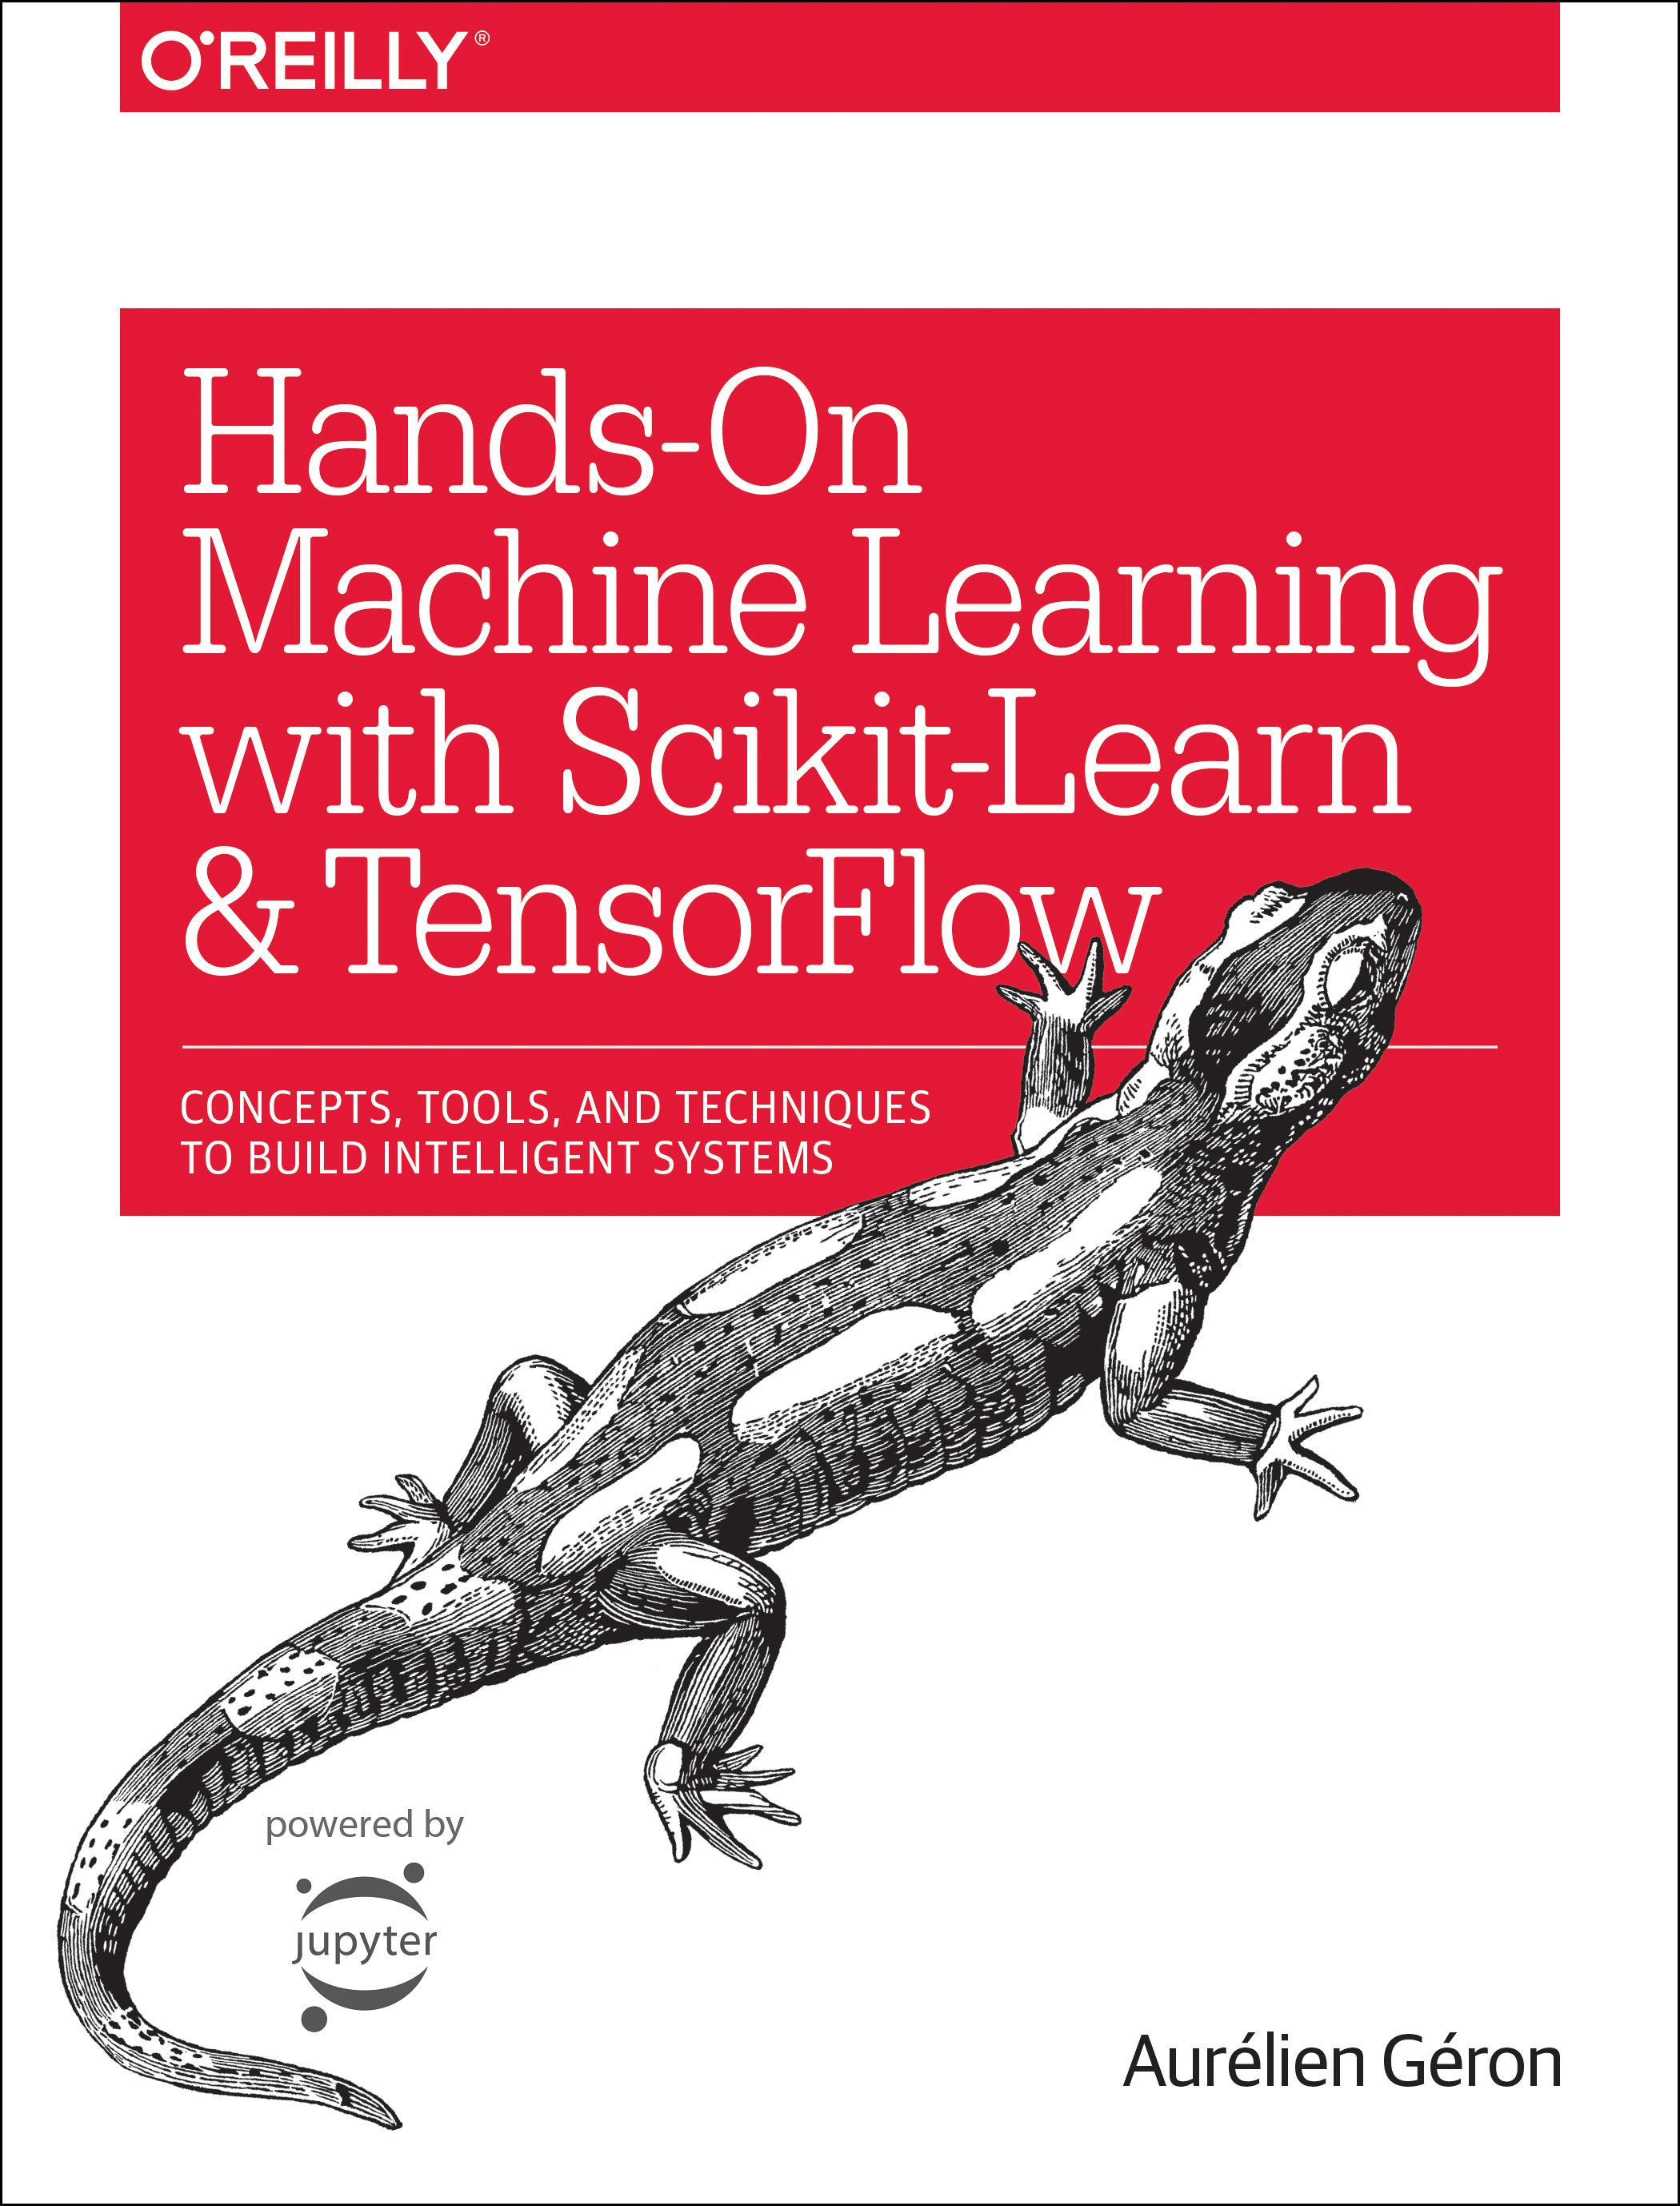
Reference
Chapter 14 (O'Reilly) of Hands-On ML
Youtube
Code

Slide 3
Data

Slide 4
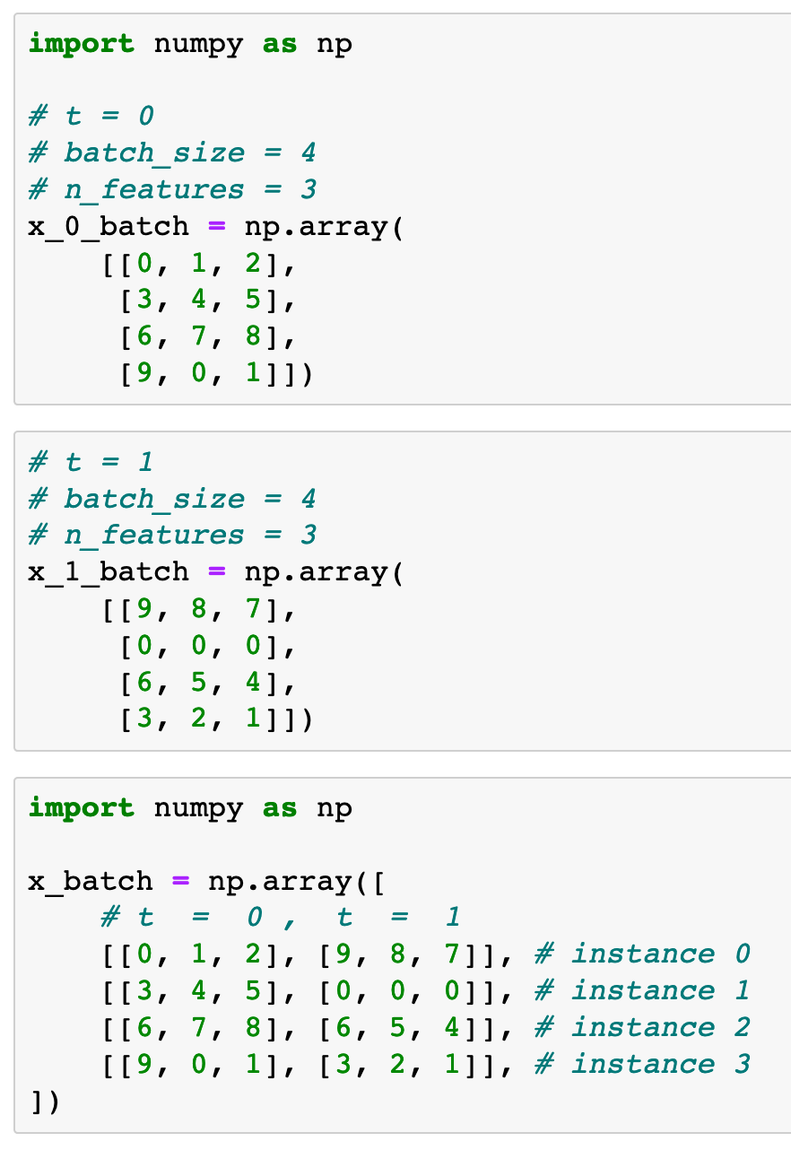

Previously
Now

Slide 5
Previously
Now

Slide 6
Graph

Slide 7
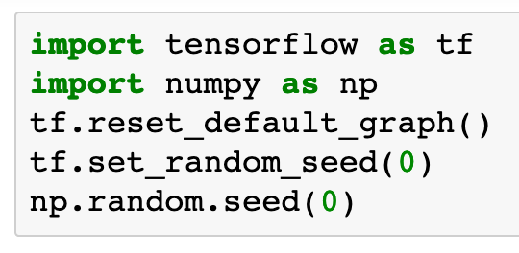

Slide 8
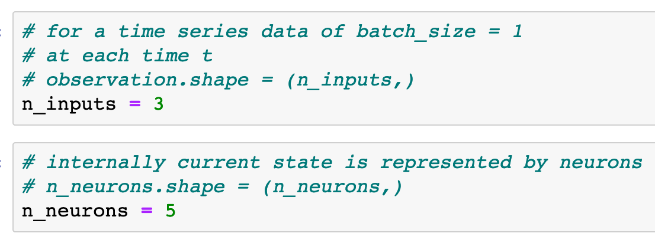

Slide 10
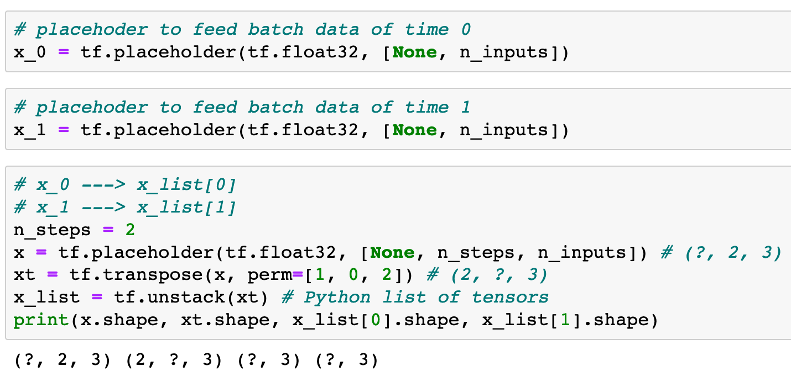
Previously
Now

Slide 11
Previously
Now

Slide 12
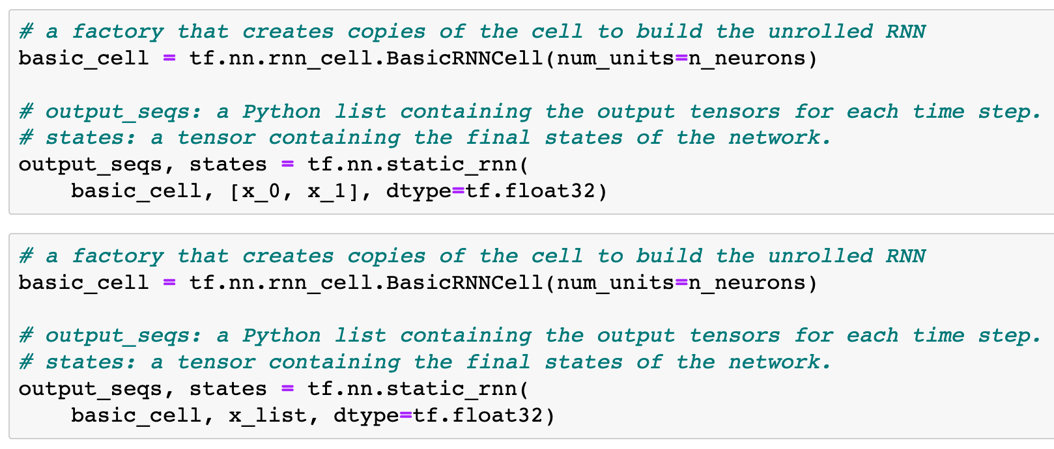

Previously
Now
Now

Slide 13
Previously
Now
Now

Slide 14
Previously
Now
Now

Slide 15
Previously
Now
Now

Slide 16
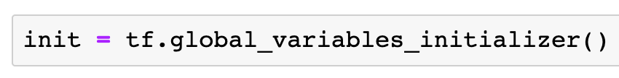

Slide 17
Session

Slide 18
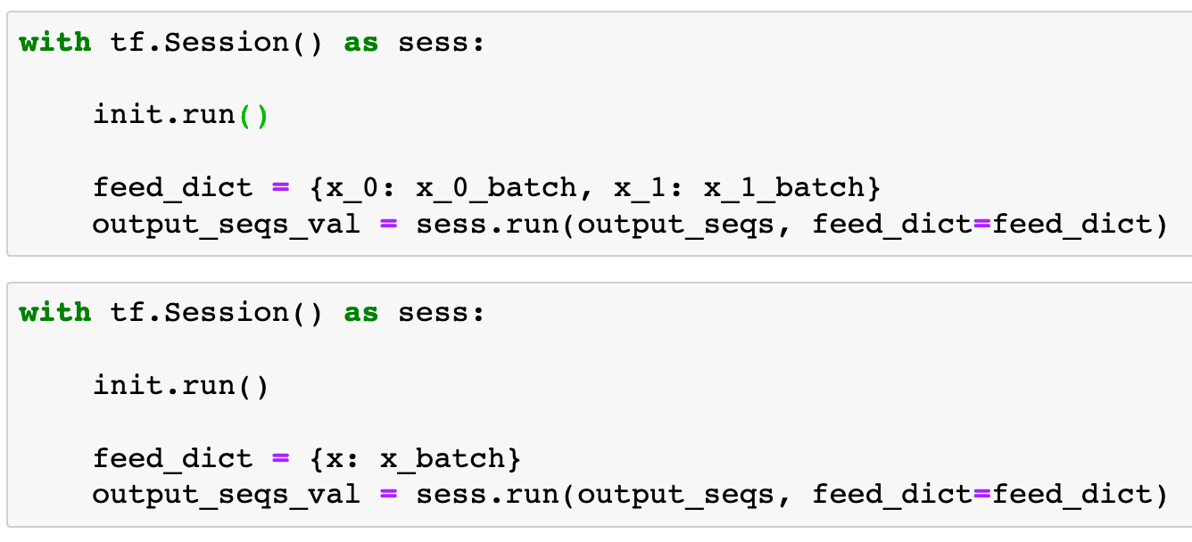
Previously
Now

Slide 19
Previously
Now

Slide 20
Previously
Now

Slide 21
Previously
Now

Slide 22
Report

Slide 23
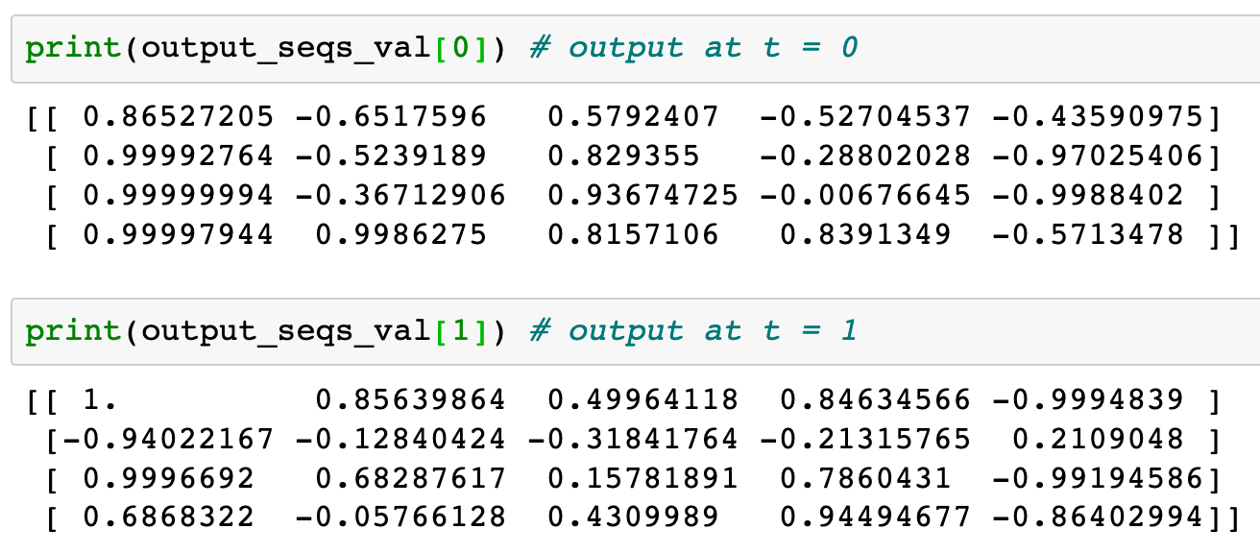

Slide 24
Now
Let’s Play with Code

